Slide 1


















TOPIC: REAL-TIME E-LEARNING SYSTEM
Presented By:
KETCHANJI VALERY DJANYA

Slide 2


PLAN
introduction
Previous system and its problems
Mission
Problems encountered
Methodology Used
TECHNOLOGY used
ADVANTAGES AND LIMITATIONS
Simulation
CONCLUSION

Slide 3

INTRODUCTION

Slide 4
PREVIOUS SYSTEM AND ITS PROBLEMS

Slide 5
MISSION
&
PROBLEMS ENCOUNTERED

Slide 6
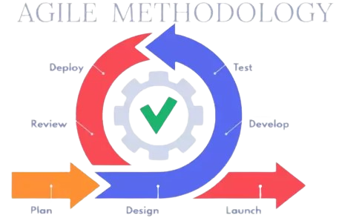











TECHNOLOGY USED AND METHODOLOGY
The Agile methodology is a way to manage a project by breaking it up into several phases.

Slide 7
ADVANTAGES AND LIMITATIONS
&
SIMULATION

